Slide 1
Application of
data-driven AI weather forecast
in Typhoon forecasting and warning
Kanghui Zhou
WMO AI support officer
Nov 2023

Slide 2
Fast development of Data driven weather forecasting
ECMWF
Peter Dueben and Peter Bauer publish a paper on using ERA5 at ~500km resolution to predict future z500.
Microsoft – ClimaX
Forecasting various lead- times at various resolutions, both globally and regionally
NVIDIA – FourCastNet Fourier+ , 0.25°
Faster & more energy efficient than IFS
Huawei – PanguWeather 0.25° hourly product
“More accurate tracks” than the IFS.
Alibaba –
SwinRDM
0.25° 6-hour product
Sharp spatial features
ECMWF – AIFS
1° /6hour
Alpha version
Aug
2018
Jan
2021
Feb
2022
Oct
2022
Nov
2022
Dec
2022
Jan
2023
Apr
2023
Jun
2023
Jun
2023
Oct
2023
ECMWF
Strategy to embed Machine Learning deeply into the ECMWF operational chain
Jua.ai
1x1km global
48 hours lead time
5 minute timesteps
Deepmind – GraphCast 0.25° 6-hour
Many variables and pressure levels with comparable skill to IFS.
FengWu – China academia + Shanghai Met Bureau 0.25° 6-hour product
Improves on GraphCast for longer leadtimes (deterministic)
NVIDIA – SFNO
0.25° 6-hour product
Extension of FourCastNet to Spherical harmonics, improved stability

Slide 3
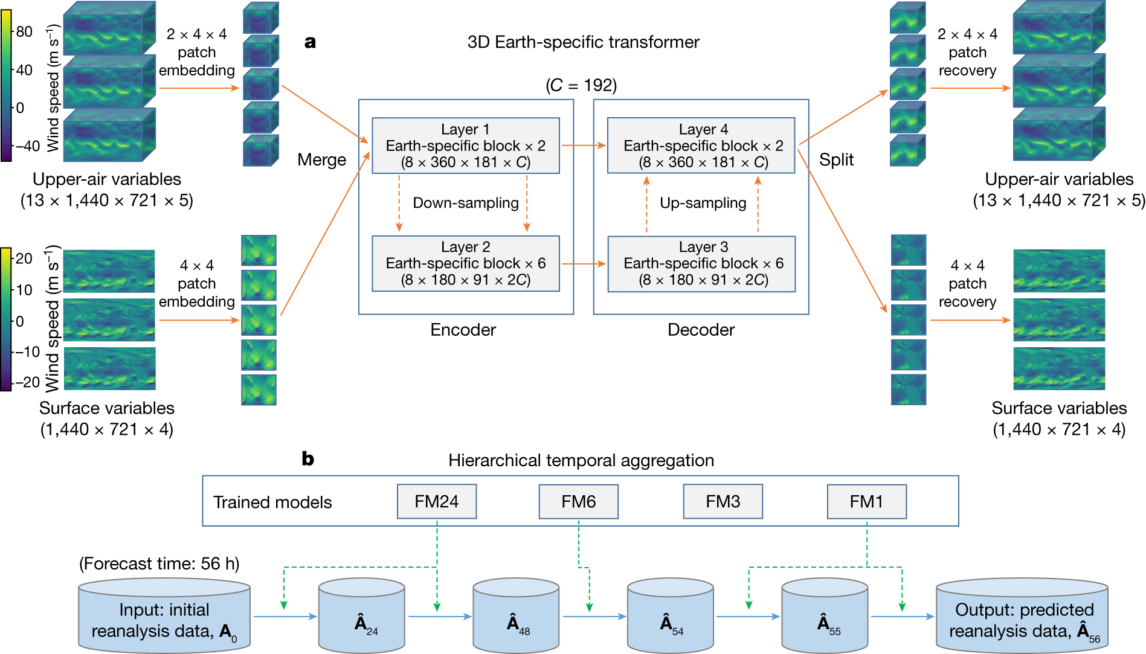
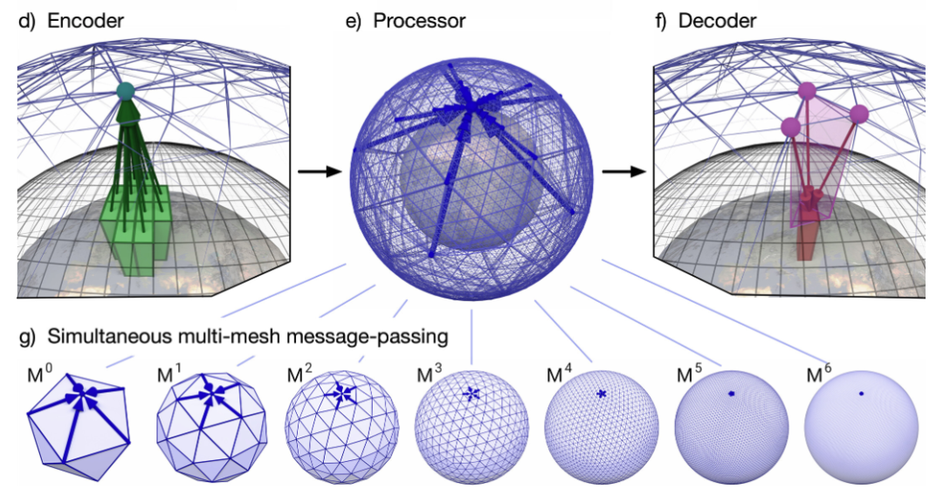
Breakthroughs in data-driven weather forecasting
Pangu-weather
Published on Nature, July 2023
Leading time: 7 days or longer
Train data: 39 years (1979–2017)
13 vertical levels
Temporal/Spatial resolution:1 h/ 0.25°
64 million parameters.
Running time 1.4 s on a single GPU
Open source, Free
GraphCast
Published on Science, Nov 2023
Leading time: over 10 days
Train data: 39 years (1979–2017)
37 vertical levels
Temporal/Spatial resolution:6 h/ 0.25°
36.7 million parameters
Running time : less than 1 min
Open source, Free
Notes:
Remi Lam et al.,Learning skillful medium-range global weather forecasting.Science0,eadi2336
Bi, K., Xie, L., Zhang, H. et al. Accurate medium-range global weather forecasting with 3D neural networks. Nature 619, 533–538 (2023).
Pangu is a primordial being and creation figure in Chinese mythology who separated heaven and earth and became geographic features such as mountains and rivers

Slide 4
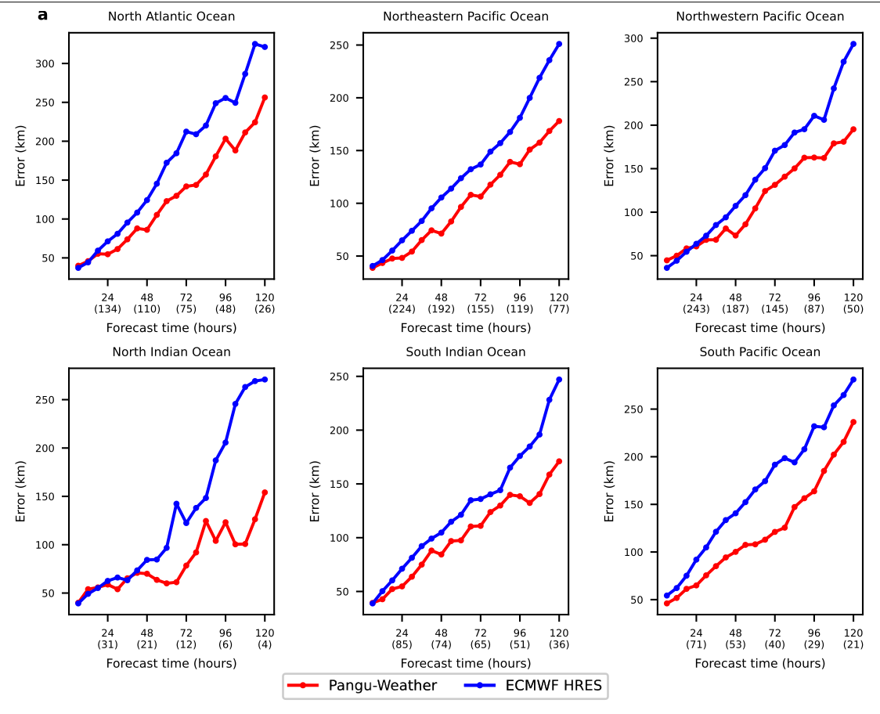
Tropical cyclone prediction-Pangu-Weather
88 cyclones in 2018 that appeared in both the International Best Track Archive for Climate Stewardship (IBTrACS) project and ECMWF-HRES
Bi, K et al. 2023

Slide 5
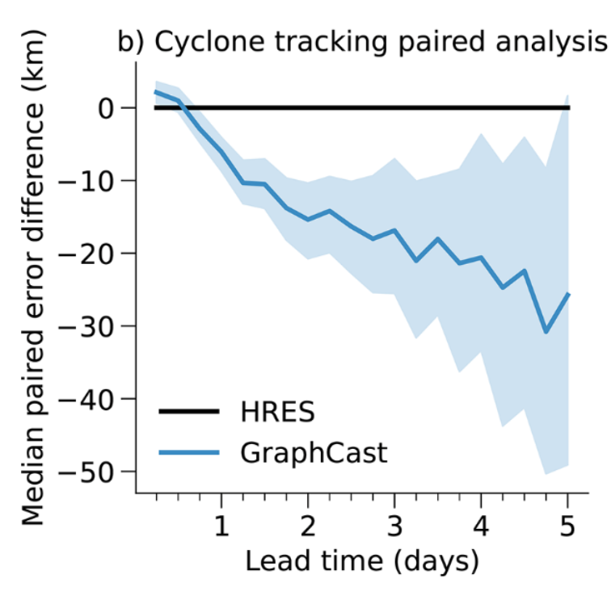
Tropical cyclone prediction-GraphCast
The tropical cyclones from 2018 to 2021 in IBTrACS dataset.
GraphCast gains ~9 hours in accuracy over ECMWF HRES’s published tracks
Remi Lam et al, 2023

Slide 6
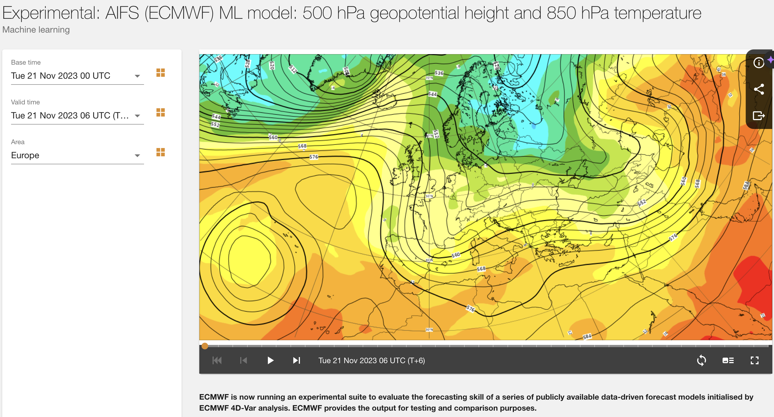
Data-driven weather forecasting in ECMWF
AIFS – Artificial Intelligence Forecasting System
ECMWF’s forecasting system that is entirely based on machine learning launched in Oct 2023.
It has a resolution of approximately one degree (111 km), and it makes predictions for wind, temperature, humidity, geopotential and more.
ECMWF now routinely running a series of global data-driven forecasts A range of ML models available in ECMWF charts catalogue
Courtesy of ECMWF

Slide 7
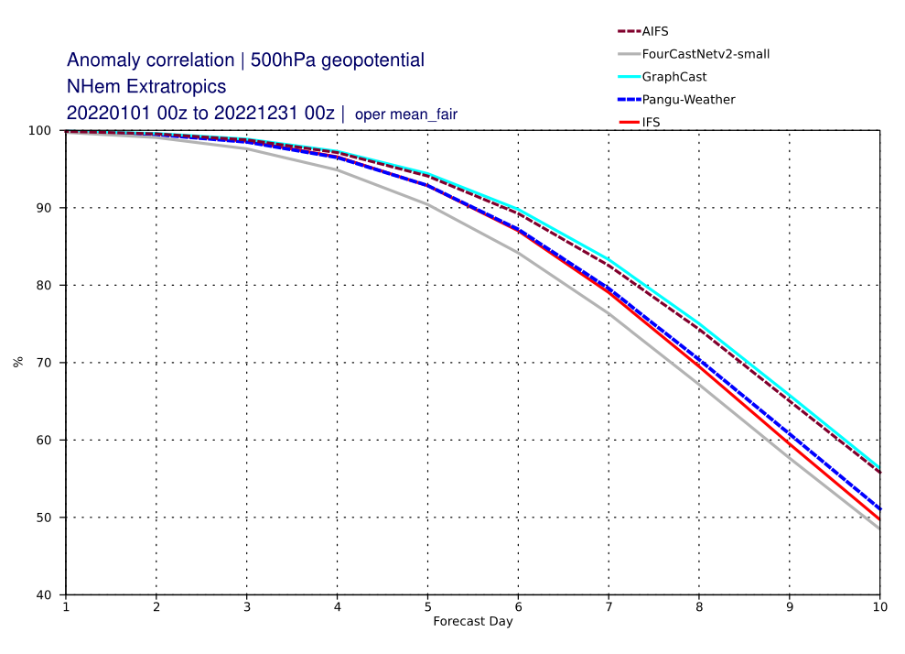
AI Forecasting System(AIFS) from ECWMF
Courtesy of ECMWF
Anomaly correlation of 144th hour weather forecasts for T850 from AI models and ECMWF's operational model(IFS) in 2022.
Anomaly correlation for next 10 days weather forecasts for H500 from AI models and ECMWF's operational model(IFS) in 2022.
Notes:
Anomaly correlations indicate whether the forecast anomaly (F–C) or whether persistence anomaly (A–C) is correlated with the verifying anomaly (V–C). For example, if the forecast is for warmer-than-climatological-normal temperatures and the verification confirms that warmer-than-normal temperatures were observed, then there is a positive correlation between the forecast and the weather. At other grid points where the forecast is poor, there might be a negative correlation. When averaged over all grid points, one hopes that there are more positive than negative correlations, giving a net positive correlation.
By dividing the average correlations by the standard deviations of forecast and verification anomalies, the result is normalized into an anomaly correlation coefficient. This coefficient varies between 1 for a perfect forecast, to 0 for an awful forecast. (For a very bad forecast the correlation can reach a minimum of –1, which indicates that the forecast is opposite to the weather. Namely, the model forecasts warmer-than-average weather when colder-than-average actually occurs, and vice-versa.)

Slide 8
Application of Data-driven Weather forecasting in CMA
Three data-driven weather forecasting models are real time running in CMA
Pangu-Weather (Huawei)
CMA National Meteorological Centre from Dec 2022
Fengwu (Shanghai Artificial Intelligence Laboratory)
CMA National Meteorological Centre-from July 2023
Shanghai Meteorological Bureau-from July 2023
Fuxi (Fudan University)
CMA National Meteorological Centre-from July 2023
Real-time diagnosis and analysis application platform for data-driven AI models
Realtime evaluation platform for Data-driven AI models
Courtesy of National meteorological Center of CMA
Notes:
Pangu (Huawei)
The National Meteorological Centre (NMC) of China Meteorological Administration (CMA) began its collaboration with Huawei at the end of 2022 to utilize the Pangu Weather Model.
Fengwu (Shanghai Artificial Intelligence Laboratory)
Operational application in the National Meteorological Centre (NMC) at the end of July and test run in Shanghai Meteorological Bureau.
Fuxi (Fudan University)
Operational application in the National Meteorological Centre (NMC) at the end of July.
Three data-driven AI models are real time running in CMA
Pangu-Weather (Huawei)
CMA National Meteorological Centre from Dec 2022
Fengwu (Shanghai Artificial Intelligence Laboratory)
CMA National Meteorological Centre-from July 2023
Shanghai Meteorological Bureau-from July 2023
Fuxi (Fudan University)
CMA National Meteorological Centre-from July 2023

Slide 9
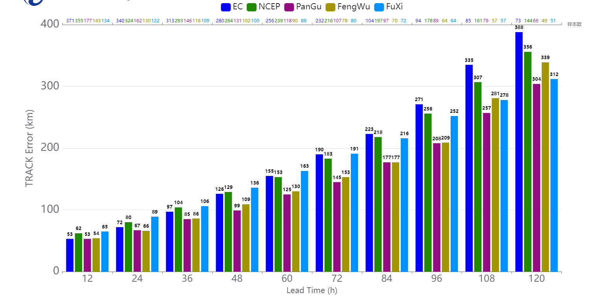
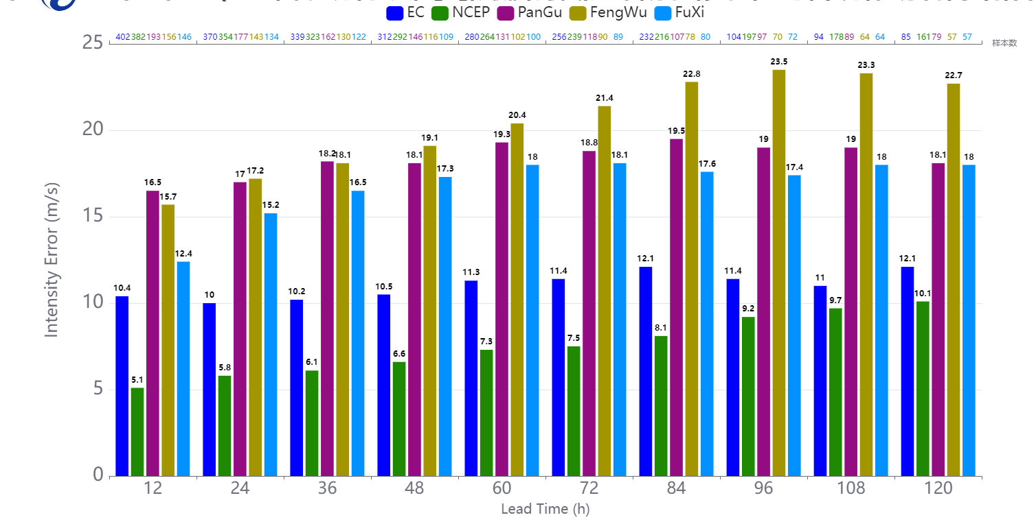
Typhoon Forecast performance-April to October 2023, CMA
Position Errors
Intensity Errors
Better performance in Typhoon position prediction
Typhoon intensity forecast need to be improved.
Extreme value prediction is still a common challenge for all AI models.
Postprocessing method could be applied in the future.
Courtesy of National meteorological Center of CMA

Slide 10
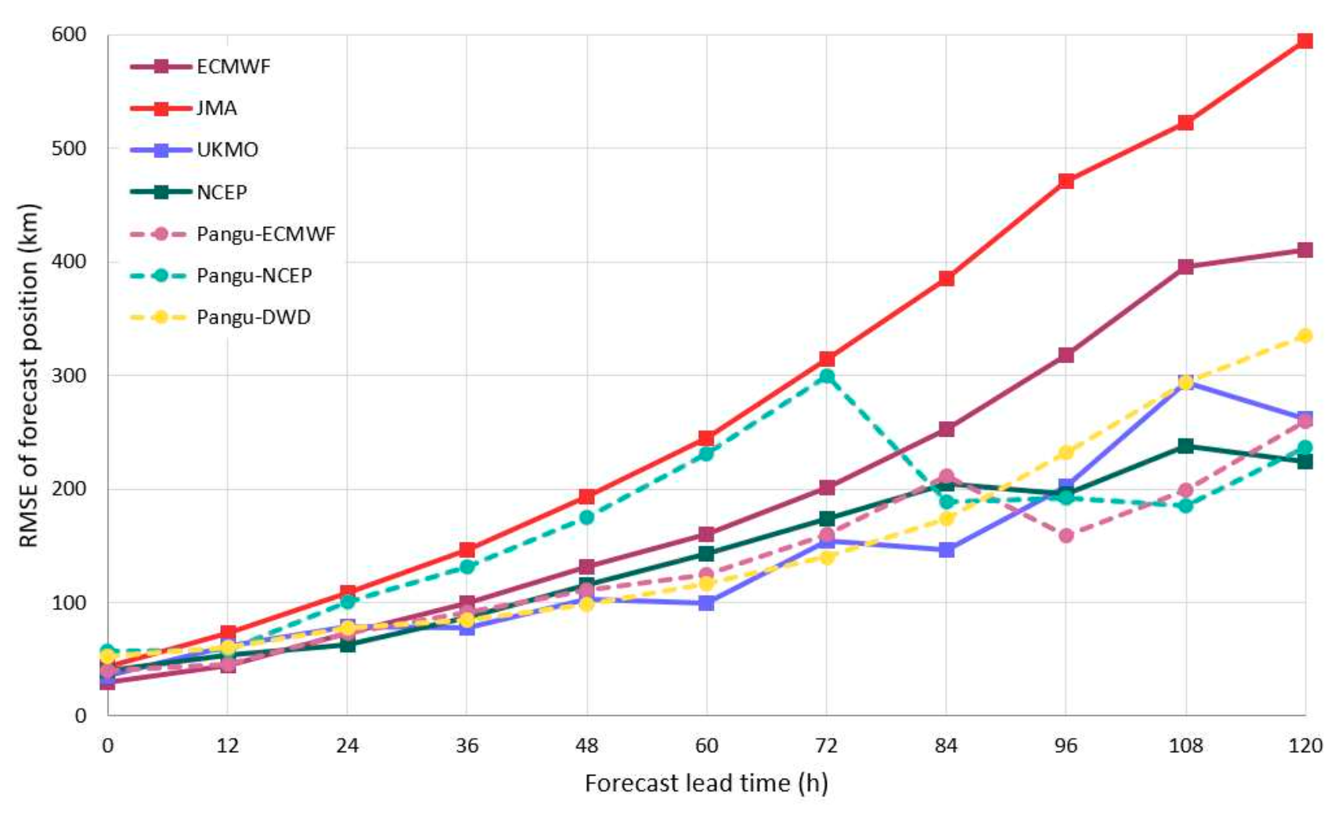
Application of Data-driven Weather forecasting in HKO
Pangu-Weather is running in HKO with initial conditions from 5 NWP models :
ECMWF
NCEP-GFS
DWD
MeteoFrance
ECCC (Environment and Climate Change Canada)
Root-mean-square error of global models’ forecast positions for Saola . Forecasts are verified against Saola’s analysis positions based on HKO operational warning track and homogenized to have a common data set among models.
Courtesy of HKO

Slide 11
WMO strategic Plan 2024-2027
Objective 2.3 Enable access to and use of numerical analysis and Earth system prediction products at all temporal and spatial scales from the WMO Integrated Processing and Prediction System
FOCUS: The implementation of new technologies, especially Artificial Intelligence (AI), encouraged
Objective 3.2 Enhance the science-for-service value cycle ensuring scientific and technological advances improve predictive capabilities and analysis
FOCUS: Capabilities for Earth system prediction and projection on all time and space scales improved including, but not limited to, emerging new methods and tools, including AI

Slide 12
AI for Nowcasting Pilot Project (AINPP)
to support the EW4ALL (in prep. phase)
Motivation
Support the EW4ALL Initiative
Research to Operation (R2O)
Support and strengthen the seamless WIPPS with AI
Narrow the AI capacity gap between WMO Members
Promote Public-Private Engagement (PPE) on AI
Outcomes
Potentially new RSMC nowcasting centers
Operational AI-based Nowcasting Products
Best practice case of AI for nowcasting
AI Guidelines and AI benchmark datasets
Transparent evaluation of methods and production chains
 | 10

Slide 14
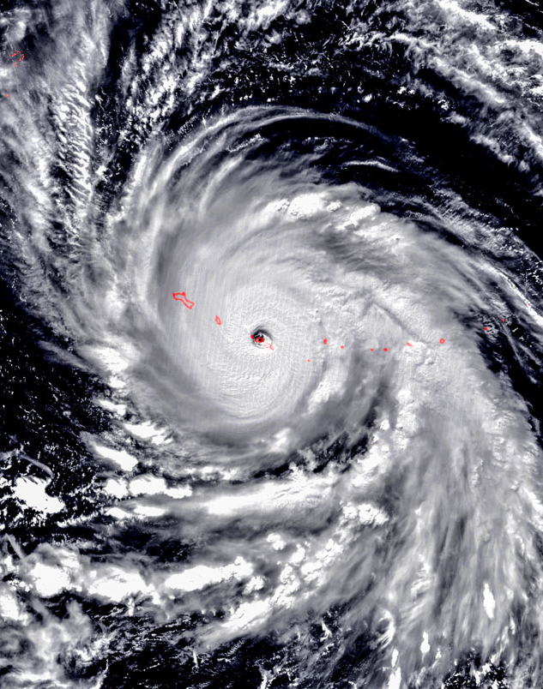
An initiative for AI for typhoon forecast demonstration project(FDP)
Goals
Investigate the impact of AI in typhoon forecasting workflow
Improve the typhoon forecasting with AI to support the EW4ALL Initiative
Comprehensively Evaluate AI’s potential for typhoon forecasting
Provide operational AI-driven Typhoon Forecasting Tools
Expected Outcomes
AI-enhanced typhoon Prediction Tools and Products, including ensemble and deterministic typhoon forecast products
Comprehensive Report on AI for typhoon prediction, including impact on typhoon operational work-flow
AI for typhoon Prediction Guidelines for WMO Members

Slide 15
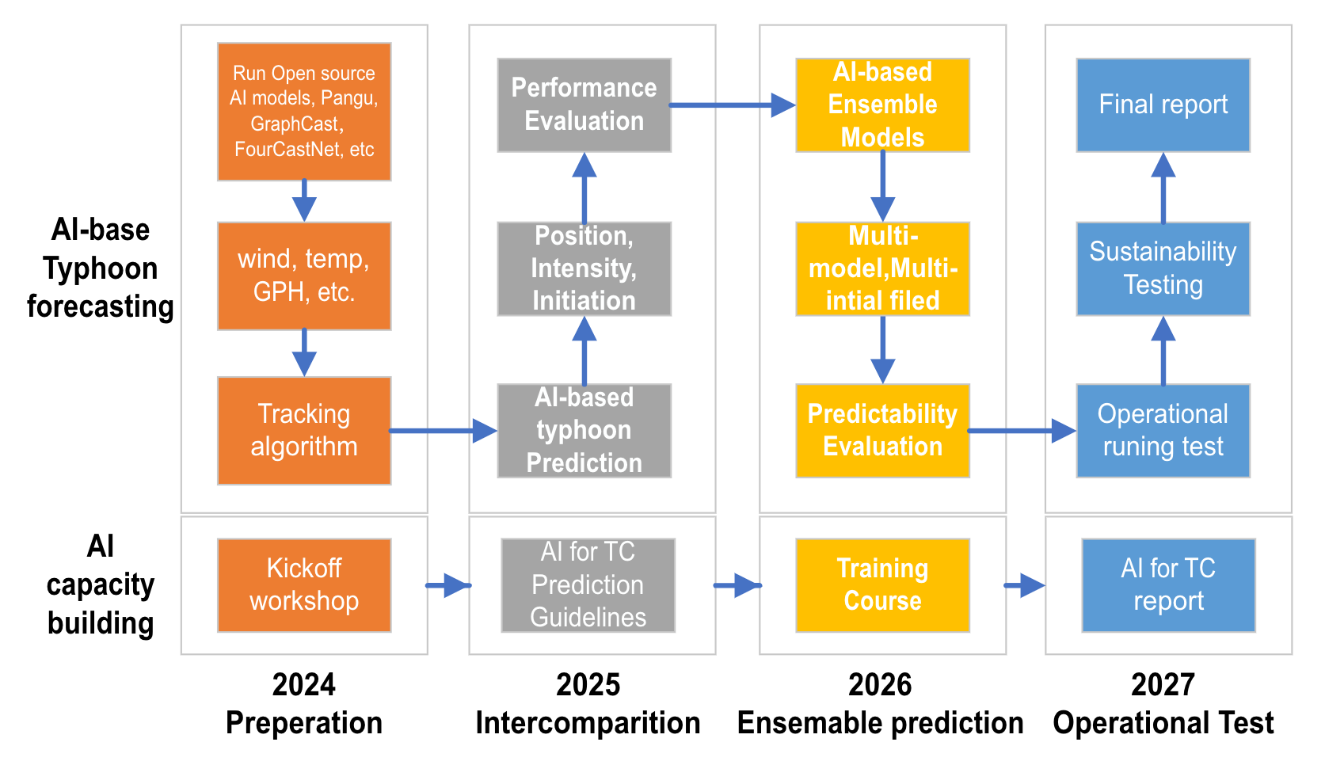
An example flow-chart of AI for typhoon FDP

Slide 16
Resource requirement
Staff
Typhoon forecaster
Typhoon forecast evaluation
AI-based forecast products visualization
IT Professionals
Run well-trained AI models
Funding
Workshops and Training
Computing station for AI models
1 GPU is enough
Notes:
Staff
Typhoon forecaster: responsible for obtaining TC position and intensity predictions based on AI model outputs.
IT Professionals: IT professionals will oversee the operation of data-driven weather forecasting models, ensuring the seamless integration of AI into operational workflows.
Data Visualization Experts: Experts in data visualization will play a crucial role in transforming AI-driven TC forecast products into user-friendly formats for dissemination to the public, emergency responders, and decision-makers.
Funding
Workshops and Training
Computing Station: A dedicated computing station is necessary for the continuous real-time operation of AI models. Funding will be allocated to acquire and maintain this essential hardware.

Slide 17
Thanks!

